Slide 1
Reporting practices of Islamic financial institutions in the BIS locational banking statistics
Siew Koon Goh
Bank for International Settlements
26 October 2017
The views expressed in this presentation are those of the presenter and do not necessarily reflect those of the Bank for International Settlements (BIS).

Slide 2
Outline
BIS locational banking statistics
Global Islamic banking assets
A questionnaire on reporting practices:
Type and size of Islamic banking institutions
Classification of financial institutions
Classification of financial instruments
Developing international guidance

Slide 3
BIS locational banking statistics
Banks located in 46 reporting countries
Capture outstanding claims and liabilities
Based on the “residence” of reporting entities
same principles as national accounts and balance of payments
Aggregated at country level

Slide 4
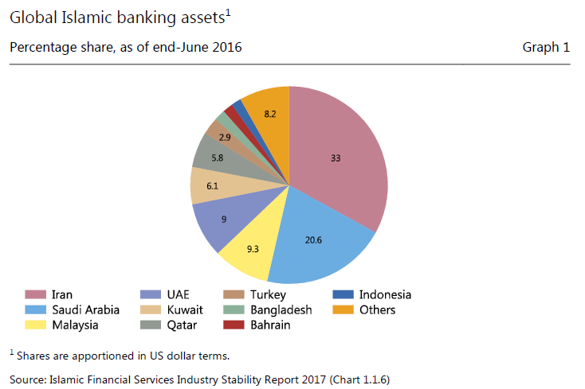
Global Islamic banking assets

Slide 5
Questionnaire on reporting practices of Islamic financial institutions
LBS-reporting countries:
Bahrain, Indonesia, Malaysia, Saudi Arabia, Turkey and United Kingdom
Questionnaire to understand:
Islamic banking business models in different countries
How central banks treat IFIs
How transactions of Islamic financial instruments are captured in statistical reporting

Slide 6
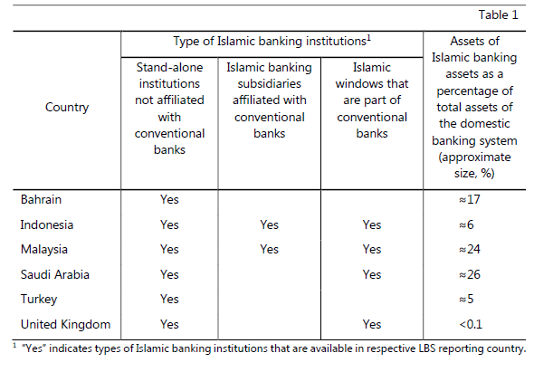
Responses to questionnaire - Islamic banking business model and size

Slide 7
Classification of financial institutions - BIS’s Guidelines
Section B.2.2
Reporting institutions generally should not include money market funds

Slide 8
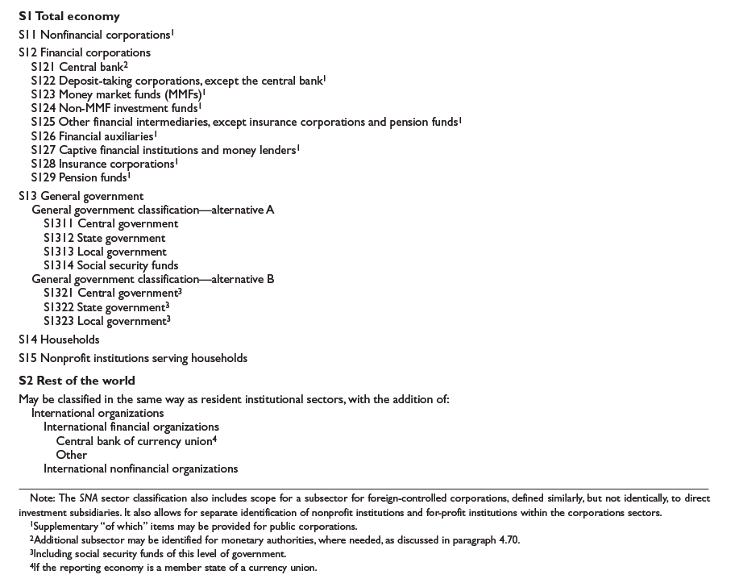
Classification of institutional sectors - 2008 SNA

Slide 9
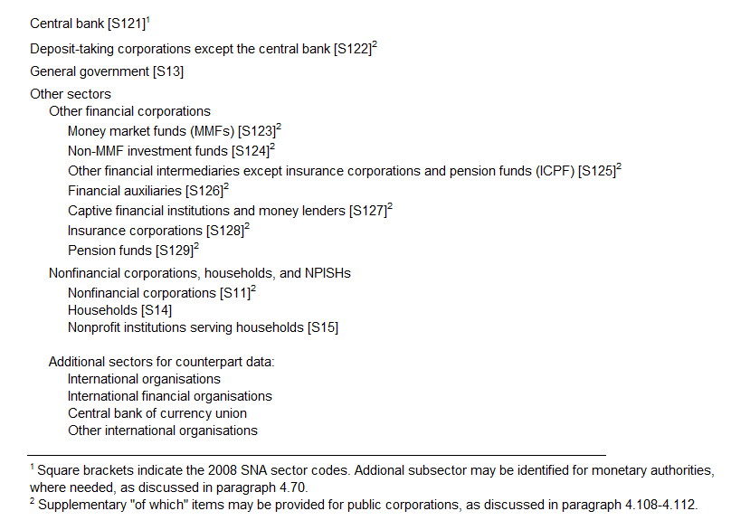
Classification of institutional sectors - BPM6

Slide 10
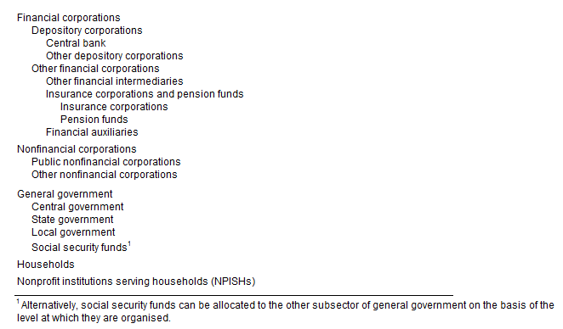
Classification of institutional sectors - MFSCG

Slide 11
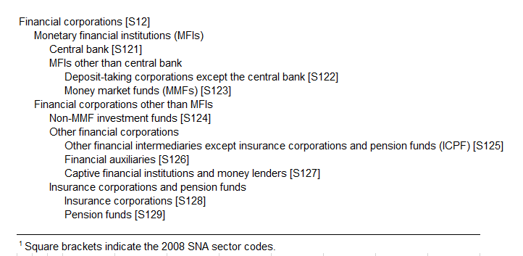
Classification of institutional sectors – ESA 2010

Slide 12
Responses to questionnaire - how central banks treat IFIs
IFIs are treated as “deposit-taking corporations except the central bank” (S.122) in LBS
No information on factors that determine these institutions be classified S.122

Slide 13
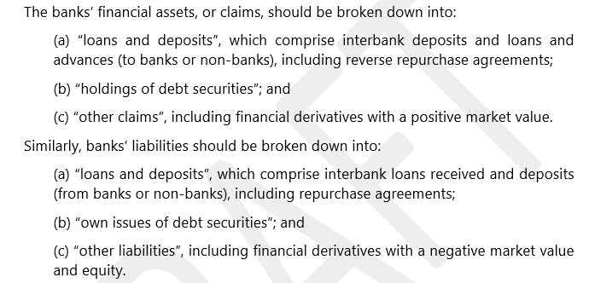
Classification of financial instruments - BIS’s Guidelines
Section B.3.1
LBS does not distinguish between loans and deposits

Slide 14
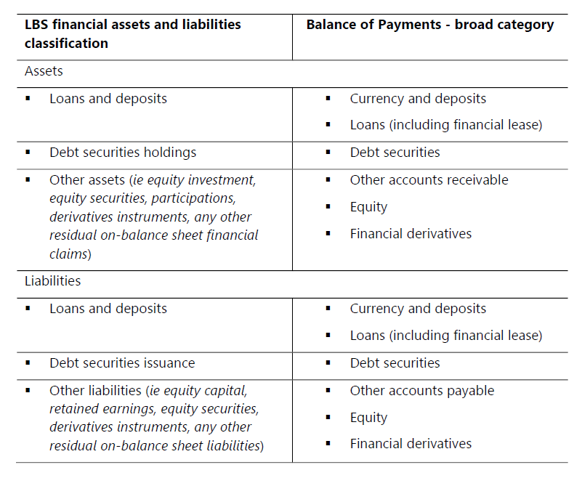
Classification of financial instruments – LBS vs BPM6

Slide 15
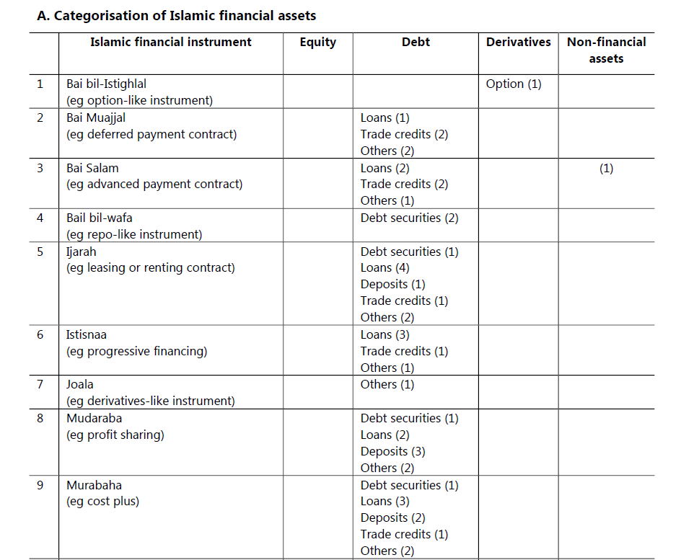
Responses to questionnaire - capturing transactions of Islamic financial instruments
…

Slide 16
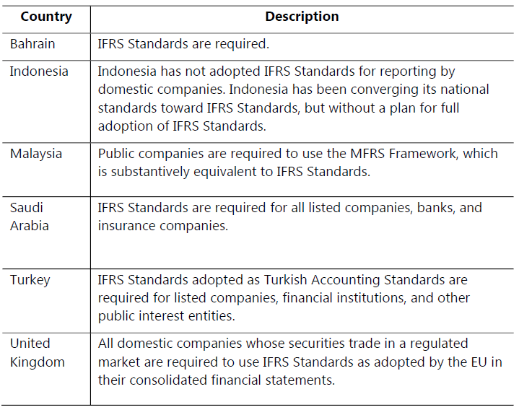
Accounting standards in selected LBS countries

Slide 17
Developing international guidance
Focus on characteristics of underlying Islamic financial products
Add a comparison of balance sheet structure between Islamic banks and conventional banks

Slide 18
Thank you!

