Slide 1
Workshop on Islamic Finance in the National Accounts COMPILATION OF THE PRODUCTION OF BANKING ACTIVITY, CASE OF CÔTE D'IVOIRE Beruit, Lebanon, 24 – 26 October 2017 Par: KOTO Ehou M’boya INSTITUT NATIONAL DE LA STATISTIQUE CÔTE D’IVOIRE Direction de la Comptabilité Nationale
UNITED NATIONS

Slide 2
Presentation's plan
Introduction;
Goals;
Management of the nomenclature;
Data collection plan;
Methodology of calculation of the production;
Estimation of the added value;
Estimation of the other resources and the uses;
Prospect
UNITED NATIONS

Slide 3
Introduction
In 2015, the Ivorian banking system include twenty six (26) banks, two (2) financial institutions and fifty six (56) Decentralized Financial Systems (SFD). Within the SFD, there is a microfinance RAOUDA Finance which operates according to Islamic finance.
Over the last five (5) years, the financial corporations sector has a share of GDP in general of 3%.
The national accounts are produced in accordance with SCN⁹³ under ERETES, a tool to assist in the compilation of national accounts.
The base year of the accounts is 1996.
Work on the changeover to the base year and transition to the 2008 SNA has begun.
UNITED NATIONS

Slide 4
GOALS
Main objective: To measure the output of banks and of SFD
Specific objectives:
Measure FISIM of banks and of SFD;
Measure the non-FISIM production of banks and of SFD.
UNITED NATIONS

Slide 5
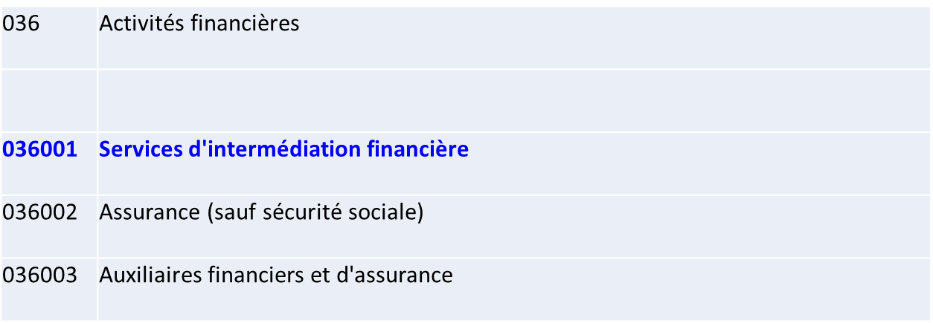
Management of the nomenclature
The position of banks in the nomenclature of Côte d'Ivoire's activities and products
Nomenclature of activities for National compatibility
The nomenclature of activities in Côte d'Ivoire is made up of 44 branches, the 36th of which concerns financial activities.
Banks are classified in sub-branch 036001.
UNITED NATIONS

Slide 6
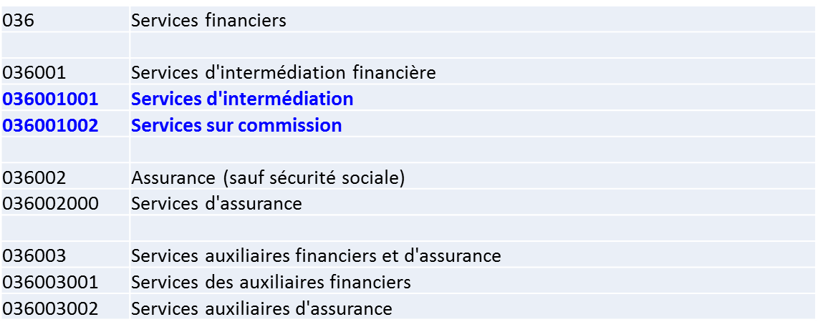
Management of the nomenclature
The position of banks in the nomenclature of Côte d'Ivoire's activities and products
Nomenclature of activities for National compatibility
The product nomenclature consists of 270 products, 2 of which are banking products (036001001 and 036001002).
UNITED NATIONS

Slide 7
Management of the nomenclature
The position of banks in the nomenclature of Côte d'Ivoire's activities and products
Nomenclature of activities for National compatibility
As part of the implementation of the 2008 SNC, National Accounting has adopted a new classification of activities and products that classify banking activities as follows:
K38 | SERVICES FINANCIERS ET D'ASSURANCE
K38001 | Services financiers
K38001001 | Service de banque centrale (administration)
K38001002 | Services d'intermédiation financière indirectement mesurés
K38001003 | Autres services financiers nca
K38002 | Service de fonds de placement holding et similaires
K38002000 | Service de fonds de placement holding et similaires
K38003 | Assurance
K38003001 | Assurance vie
K38003002 | Assurance IARD
K38004 | Services des auxiliaires financiers et d'assurance
K38004001 | Service de transfert de fonds
K38004002 | Autres Services auxiliaires financiers
K38004003 | Services auxiliaires d'assurance
UNITED NATIONS

Slide 8
Management of the nomenclature
Position of banks in the nomenclature of institutional sectors
from Côte d’Ivoire
The banks are part of the financial corporations sector which is constituted as follows:
0S1002 | Sociétés financières
0S1002001 | Banque centrale
0S1002002 | Autres institutions de dépôts
0S1002003 | Autres intermédiaires financiers, hors sociétés d'assurance et des fonds de pension
0S1002004 | Auxiliaires financiers
0S1002005 | Sociétés d'assurance et fonds de pension
UNITED NATIONS

Slide 9
Data collection plan
Source, periodicity, information collected link to national accounting, level of source aggregation
UNITED NATIONS

Slide 10
Data collection plan
Traitement des sources (1/2)
Processing of Raouda Finance: its processing is identical to the processing of the conventional SFD because its profit and loss account does not distinguish itself from other SFD;
The Processing of the SFD is similar to that of banks with the exception of the central Bank which has a particular processing
Processing of the Central Bank: the Central Bank publishes a financial statement strengthened by its member states..
The estimation of the net income statement(profit and loss account) of the national agency of the Central Bank is made on the basis of the weight of the GDP(GROSS DOMESTIC PRODUCT) of Côte d’Ivoire in the global GDP(GROSS DOMESTIC PRODUCT) of UEMOA. This ratio is used to determine the clear(net) income statement(profit and loss account) of the national agency of the BCEAO
UNITED NATIONS

Slide 11
Data collection plan
Treatment of sources(2/2)
Translate the economic data received from banks in language of national accounting by means of a table of passage;
Calculation of the production of banks.
UNITED NATIONS

Slide 12
Methodology of calculation of the production
Estimated production at current prices
Production of banks consists of :
Services Charged;
Services rendered by financial institutions to other institutional sectors when lending money or when managing their deposits: SIFIM (Indirectly Measured Financial Intermediation Service).
UNITED NATIONS

Slide 13
Methodology of calculation of the production
Estimated production at current prices
Production outside SIFIM
The production of none-SIFIM banks comes from banking services explicitly invoiced in the form of commissions for specialized services provided by banks: file instructions, bank transactions (bank transfer, credit cards, account and securities management), etc…
UNITED NATIONS

Slide 14
Methodology of calculation of the production
Estimated production at current prices
FISIM
FISIM = Difference between the interests received from the loans and those paid on the deposits.
Interest received and paid is from banks and SFD.
UNITED NATIONS

Slide 15
Added estimation of the value(VA)
Estimated value added
The added value cleared by the services charged of banking activity results from the subtraction of the production of the banking service to the amount of intermediate consumption (CI).
The CI corresponds to current expenses (external loads connected to external services and to other external services) which banks face within the framework of their activity.
VA = P - CI
UNITED NATIONS

Slide 16
Estimates of other resources and Uses
Balance Resource Use
The imports and the exports of banking services result from the balance of payments;
The balance is shared between CI and CF.
For the sharing volume price : the index harmonized by consumer prices is used for the estimation of the volume
UNITED NATIONS

Slide 17
Prospect
A mode unique production for Finance companies was to create with the implementation of SCN2008;
Produce the financial accounts of the institutional sectors..
UNITED NATIONS

Slide 18
Thank you for your attention!!!
UNITED NATIONS

