Slide 1
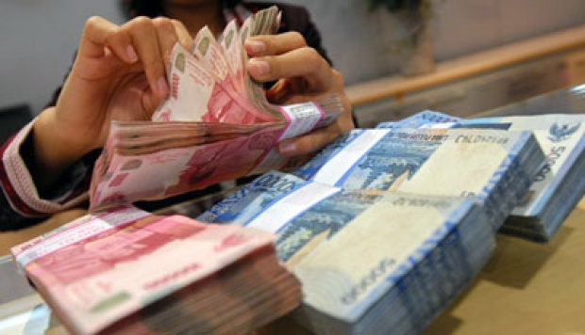
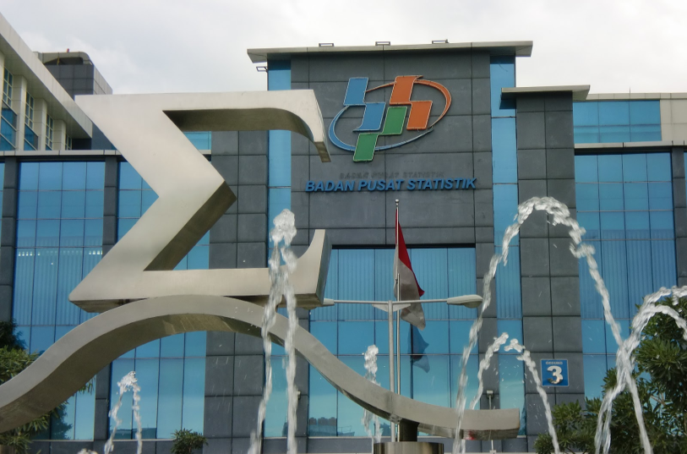
Suswandi
Development of Islamic Financial Institution in Indonesia
Beirut, Oct 24-26, 2017

Slide 2
Outline Presentation
Financial Institution and Capital Market in Indonesia
Economic Growth
Islamic Financial Institution and Capital Market
Islamic Finance in Indonesia’s National Account

Slide 3
Economic Growth

Slide 4
Indonesia and Global Economic Growth

Slide 5
Indonesia GDP Growth by Expenditure on Q2-2017

Slide 6
Distribution of GDP Expenditure on Q2-2017

Slide 7
Indonesia GDP Growth by Production on Q2-2017

Slide 8
Distribution of GDP Production on Q2-2017

Slide 9
Financial Institution and Capital Market in Indonesia

Slide 10
General Conditions of Conventional Banks
Ratio | 2012 | 2013 | 2014 | 2015 | 2016 | y-on-y
Conventional Commercial Banks
Total Assets (Rp billons) | 4.115.003 | 4.773.892 | 5.410.098 | 5.919.390 | 6.475.602 | 9,40%
Credit (Rp billons) | 2.597.026 | 3.158.099 | 3.526.364 | 3.903.936 | 4.199.713 | 7,58%
Deposits (Rp billons) | 3.107.385 | 3.520.616 | 3.943.697 | 4.238.349 | 4.630.352 | 9,25%

Slide 11
Rural Bank Performance Indicators
Ratio | 2012 | 2013 | 2014 | 2015 | 2016 | y-on-y
Total Assets (Rp billions) | 67.397 | 77.376 | 89.878 | 101.713 | 113.510 | 11,59%
Credit (Rp billions) | 49.818 | 59.176 | 68.391 | 74.807 | 81.684 | 9,19%
Deposits (Rp billions) | 44.870 | 50.520 | 58.750 | 67.266 | 75.725 | 12,58%

Slide 12
Stock Trading by Foreign and Domestic Investors
Indicator (Daily Average) | 2014 | 2015 | 2016
Average Daily Value of Stock Trading (Rp billions) | 6.005,75 | 5.763,78 | 7.498,32
Foreign Investors (Rp billions) Buy Value Sell Value | 2.524,86 2.348,84 | 2.443,97 2.536,55 | 2.798,75 2.733,02
Domestic Investors (Rp billion) Buy Value Sell Value | 3.480,89 3.656,92 | 3.319,81 3.227,23 | 4.699,58 5.765,30
Daily Stock Trading Frequency | 212.635 | 221.583 | 264.127

Slide 13
Bond Trading Transaction
Transaction Type | 2015 |  | 2016
 | Volume (Rp trillions) | Value (Rp trillions) | Volume (Rp trillions) | Value (Rp trillions)
Bonds
Corporate | 187,66 | 186,05 | 224,30 | 225,14
Goverment | 3.399,94 | 3.401,12 | 3.653,30 | 3.749,57
Total | 3.587,60 | 3.587,17 | 3.877,60 | 3.974,71
Repo | 144,44 | 133,88 | 272,18 | 263,17

Slide 14
Number of Securities Companies
Operating License | Total
Broker – Dealer | 36
Underwriter | 3
Broker – Dealer + Underwriter | 88
Broker – Dealer + Investment Manager | 2
Underwriter + Investment Manager | -
Broker – Dealer + Underwriter + Investment Manager | 3
Total | 132

Slide 15
Non Banking Assets from 2012-2016 (Rp Triliun)
Industry | 2012 | 2013 | 2014 | 2015 | 2016
Insurance | 584,02 | 659,73 | 807,68 | 853,42 | 977,82
Pension Funds | 158,37 | 162,44 | 187,52 | 206,59 | 238,30
Finance Companies | 356,30 | 420,17 | 443,74 | 473,42 | 510,31
Special Financial Services Institutions | 75,79 | 96,37 | 116,70 | 147,83 | 185,55
Supporting Services | 3,49 | 4,29 | 5,42 | 6,04 | 7,25
Microfinance Institutions | - | - | - | 0,05 | 0,28
Total Assets | 1.177,97 | 1.343,00 | 1.561,06 | 1.687,35 | 1.919,51
Note: Based on unaudited financial data as of 31st December 2016

Slide 16
Number of Non Banking Institution at of 31st Dec 2016

Slide 17
Invest Distr of Pension Funds 2012-2016 (Rp trillion)

Slide 18
Assets, Liabilities, and Equity Growth of Finance Companies (Rp trillion)

Slide 19
Islamic Financial Institution and Capital Market

Slide 20
Sharia Banking Indicators
Main Indicator | Q4-2015 | Q1-2016 | Q2-2016 | Q3-2016 | Q4-2016 | Growth (y-on-y)
 |  |  |  |  |  | Value | %
Total Assets of Sharia Banks + Sharia Business Units (Rp trillions) | 296,26 | 297,77 | 306,22 | 331,76 | 356,50 | 60,24 | 20,33
Total Assets of Sharia Rural Banks (Rp trillions) | 7,74 | 7,95 | 8,12 | 8,60 | 9,16 | 1,42 | 18,33
Share of Sharia Bank + Rural Banks) to Total Assets of National Banking Industry | 4,87 | 4,87 | 4,85 | 5,17 | 5,32 |  | 0,47

Slide 21
Indonesia Sharia Stock Market Capitalization (Rp trillion)

Slide 22
Corporate Sukuk Issuances
Year | Sukuk Issuance |  | Outstanding Sukuk
 | Total Value (Rp billions) | Total | Total Value (Rp billions) | Total
2010 | 7.815 | 47 | 6.121 | 32
2011 | 7.915 | 48 | 5.876 | 31
2012 | 9.790 | 54 | 6.883 | 32
2013 | 11.994 | 64 | 7.553 | 36
2014 | 12.956 | 71 | 7.105 | 35
2015 | 16.114 | 87 | 9.902 | 47
2016 | 20.425 | 102 | 11.878 | 53

Slide 23
Sharia Investment Funds Performance
Year | Sukuk Issuance |  |  |  | Outstanding Sukuk
 | Sharia Investment Funds | Conventional Investment Funds | Total Investment Funds | % | Sharia Investment Funds | Conventional Investment Funds | Total Investment Funds | %
2011 | 50 | 596 | 646 | 7,74% | 5.564,79 | 162.672,10 | 168.236,89 | 3,13%
2012 | 58 | 696 | 754 | 7,69% | 8.050,07 | 204.541,97 | 212.592,04 | 3,79%
2013 | 65 | 758 | 823 | 7,90% | 9.432,19 | 183.112,33 | 192.544,52 | 4,90%
2014 | 74 | 820 | 894 | 8,31% | 11.236,00 | 230.225,59 | 241.462,09 | 4,65%
2015 | 93 | 998 | 1.091 | 8,52% | 11.019,43 | 260.949,57 | 271.969,00 | 4,05%
2016 | 136 | 1.289 | 1.425 | 9,54% | 14.914,63 | 323.835,18 | 338.749,81 | 4,40%

Slide 24
Outstanding Government Islamic Securities (SBSN) Performance
Year | Value Outstanding | Total Outstanding
2010 | 44,34 | 16
2011 | 77,73 | 22
2012 | 124,44 | 36
2013 | 169,29 | 42
2014 | 206,10 | 42
2015 | 296,07 | 47
2016 | 411,37 | 53

Slide 25
Sharia Nonbank Financial Industry Asset Growth from 2012-2016 (Rp Billion)
Industry | 2012 | 2013 | 2014 | 2015 | 2016
Sharia Insurance Companies | 13.239,00 | 16.674,55 | 21.742,13 | 25.399,08 | 33.243,51
Sharia Finance Companies | 22.664,34 | 24.638,98 | 23.767,63 | 22.530,38 | 35.740,95
Sharia Venture Capital Firms | 225,29 | 311,16 | 384,18 | 414,33 | 1.092,47
Sharia Infrastructure Financing Companies | - | - | - | - | 104,54
Sharia Guarantee Companies/Sharia Special Financial Institutions | - | 102,84 | 376.89 | 618,29 | 18.428,99
Sharia Micro-Finance Institutions | - | - | - | - | 63.435
Total | 36.128,63 | 41.700,63 | 46.270,83 | 48.782,09 | 88.673,91

Slide 26
Number of Sharia Insurance Companies from 2012-2016
Industry | 2012 | 2013 | 2014 | 2015 | 2016
Sharia Life Insurance Companies | 3 | 3 | 3 | 5 | 6
Life Insurance Companies with a Sharia Business Unit | 17 | 17 | 18 | 19 | 21
Sharia General Insurance Companies | 2 | 2 | 2 | 3 | 4
General Insurance Companies with a Sharia Business Unit | 20 | 24 | 23 | 25 | 24
Sharia Reinsurance Company | - | - | - | - | 1
Sharia Reinsurance Company with a Sharia Business Unit | 3 | 3 | 3 | 3 | 2
Total | 45 | 49 | 49 | 55 | 58

Slide 27
Number of Sharia Finance Companies from 2012-2016
Industry | 2012 | 2013 | 2014 | 2015 | 2016
Sharia Finance Companies | 2 | 2 | 3 | 3 | 3
Finance Companies with a Sharia Business Unit | 32 | 42 | 41 | 37 | 38
Sharia Venture Capital Firm | - | 4 | 4 | 4 | 4
Venture Capital Firm with a Sharia Business Unit | - | - | - | 2 | 3
Sharia Infrastructure Finance Company; Infrastructure Finance Company with a Sharia Business Unit | - | - | - | - | 1
Total | 34 | 48 | 48 | 46 | 49

Slide 28
Number of Sharia Special Financial Institution from 2012-2016
Industry | 2012 | 2013 | 2014 | 2015 | 2016
Sharia Guarantee Company | - | 2 | 2 | 2 | 2
Guarantee Company with a Sharia Business Unit | - | - | 1 | 1 | 2
PT.Pegadaian (persero) with a Sharia Business Unit | 1 | 1 | 1 | 1 | 1
Indonesia Eximbank with a Sharia Business Unit | 1 | 1 | 1 | 1 | 1
Total | 2 | 4 | 5 | 5 | 6

Slide 29
Islamic Financial Institution in Indonesia based on Asset Ratio

Slide 30
Islamic Finance in Indonesia’s National Account

Slide 31
SECTORING AND SUBSECTORING
1
HOUSEHOLD
4
NON FINANCIAL CORPORATION
Public NF Corp.
Private NF Corp.
2
NPISH
5
FINANCIAL CORPORATION
Central bank
DTC except CB
IC
PF
Leasing company
Pawnshop
Other
3
GOVERNMENT
6
REST OF THE WORLD
Notes:
Most of the pictures taken from freepik.com with modification

Slide 32
COVERAGE
NON-FINANCIAL CORPORATION
HOUSEHOLD
Public
SOE
ROE
Private
Listed Company
Unlisted Company (incl. quasi corporation)
All units of resident households
NPISH
Political Parties
Social Organizations
Professional Organizations
Community Brotherhood/ Sports Club/ Hobby/ Art & Culture
Self-Help Foundation
Religious Organizations
Humanitarian Aid Organizations & Scholarship
FINANCIAL CORPORATION
Central bank
Depository corporation except central bank
Insurance company
Pension fund
Leasing
Pawnshop
Other
GENERAL GOVERNMENT
Central Government
Local Government (Provinces, Regencies, and Villages)
Public Services Agency (BLU)
REST OF THE WORLD
All transaction between resident and non resident

Slide 33
DATA SOURCES (1)
NPISH
MAIN AND SUPPORTING DATA
Main Data Sources :
Special Survey of Non-profit Institutions serving Households (SKLNP)
Supporting Data Sources :
Population of NPISH from:
Village Potential Census PODES
Directory from other institutions : Ministry of Home Affair, Min. of Religious Affair, etc
HOUSEHOLD
Main Data Sources:
Special Survey of Household Savings and Investment (SKTIR)
National Socioeconomic Survey (SUSENAS)
GENERAL GOVERNMENT
Supporting Data Sources:
Compensations of Employees, Labor Force Survey (SAKERNAS)
Value added of micro and small business, UMKM Surveys
Data and indicators from other institutions, e.g: Central Bank (BI), OJK, Ministry of Cooperative, Tax Office, etc
Main Data Sources :
Central Gov. Budget Realizations , MoF
Local Gov. Budget Realization from Provinces and Regency , BPS
Village’s Financial Statistics, BPS
Central government spending (11 digits), Fiscal Policy Office MoF
Cash transfer to the poor and family allowance realization, DG of Budget MoF

Slide 34
DATA SOURCES(2)
FINANCIAL CORPORATION
MAIN AND SUPPORTING DATA
Main Data Sources :
Financial company report from Central Bank ; OJK ; and Pawnshop
NON-FINANCIAL CORPORATION
Note :
The financial statements of the company consists of a year-end balance sheet, profit and loss statements, and changes in equity
The financial statements of the company have a different format
The financial statements used in the form of consolidation report
Main Data Sources :
The financial statements of companies listed on the Indonesia Stock Exchange (IDX)
Note:
The financial statements of the company consists of a year-end balance sheet, profit and loss statements, and changes in equity
The financial statements of the company have a different format
Special Survey of Non-Financial Corporation (SKPS)
UMKM Survey from Directorate of Production Account
SOE’s financial report, Ministry of SOE
Regional Owned Ent. Survey, BPS
REST OF THE WORLD
Main Data Sources :
Export and import reports/documents(PEB/PIB)
BOP and IIP
Note :
PEB, PIB, and BOP used to estimate current account
IIP used to estimate accumulation account

Slide 35
Current Progress of FSA
Cooperation with several institutions have been developed such as Bank Indonesia, Ministry of Finance, OJK, Investment board (BKPM), Kemeneg BUMN etc. MoU of BPS-OJK and BPS-BI have been proposed.
Preliminary figures of FSA year 2010 and 2011 are available and consistent with Supply and Use Table.
Identification and estimation of institutional unit
Identification of concepts, coverage, data sources, classification & methodology
Construction of “From whom to whom“ for Financial instruments in Financial account (Bonds, equity, deposits, financial derivative and etc)
Matrice of balance for interest, transfer, dividend, etc.
Valuation of transaction and Revaluation in financial account
1 : central government
33 : province
505 : city/municipality
70 000 : village
Population Estimation of Institutional Units
Households
General Government
Non-Financial Corporation
Financial Corporation
NPISH
Rest of the world
Numerous
$$64 million$$
$$2,4 million$$
$$70,538$$
$$3.300$$
Listed : 308
Unlisted : many
State owned Enterprise : 120
Local gov. owned Enterprise : 570

Slide 36
Treatment of Islamic Financial Institution in Indonesia
Islamic Financial Institutions are growing bigger in later few years (2012-2016).
Share of Islamic Financial Institutions are relative small (around 5%) compare with conventional ones.
Indonesia do not yet treatment in islamic finance due to lack of the manual and country practice.

Slide 37
THANK YOU -STATISTICS INDONESIA- -BADAN PUSAT STATISTIK-
www.bps.go.id
bpshq@bps.go.id
(021) 3841195, 3842508, 3810291

