Slide 1
National Accounts in SURINAME with a special focus on the Banking sector Lebanon, 24-26 October 2017
Presenter:
Denise Sjahkit-Wagiman
Suriname

Slide 2
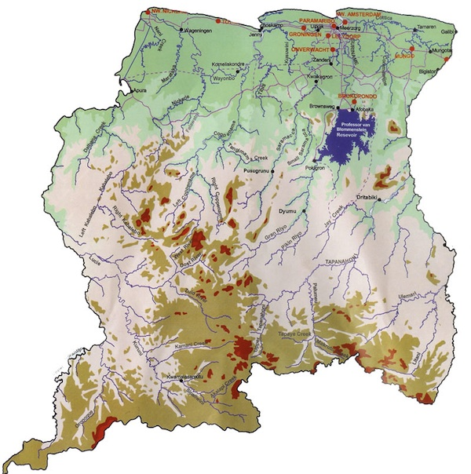

Slide 3
Key Figures of Suriname
Republic
Independent | November 25, 1975
Capital | Paramaribo
Area | 163,820 km²
Population | 541,638 (Census 2012)
Official language | Dutch
Gross Domestic Product 2015 (Basic prices) | 15,083,951 (*1000 SRD)
Gross Domestic Product 2015 (Market prices) | 16,669,281 (*1000 SRD)
Real growth 2015 (Base Year 2007) | -2.7%
Exchange Rate 2016 | Monthly average
Per 1 US$ | 6.33 SRD
Per 1 Euro | 7.23 SRD

Slide 4
Outline
Introduction (inclusive of short history of Nat. Acc. Compilation in Sur.)
Overview of the main legal issues
Scope (why do we need good Nat. Acc. Stats)
Current compilation practices
Data sources
Banking sector
Islamic Banking in Suriname
Challenges
Table (Macroeconomic Aggregates)

Slide 5
Introduction (inclusive of short history of Nat. Acc. Compilation in Sur.)
In March 1973, the General Bureau of Statistics (GBS) commenced producing National Accounts Statistics for Suriname and the first publication, pertaining to the year 1972 was released in January 1974.
That publication was partly based on the System of National Accounts of the Netherlands issued by the Central Bureau of that country and partly on the system as recommended by the United Nations in a System of National Accounts 1968 (SNA 68).
The broad objective of the System of National Accounts is to provide a comprehensive conceptual and accounting framework for compiling and reporting macroeconomic statistics for analyzing and evaluating the performance of an economy

Slide 6
Overview of the main legal issues
The Foundation General Bureau of Statistics (GBS) is responsible for collecting, processing, and disseminating of National Accounts (NA), Nationally and Internationally.
The GBS is governed by Law SB.2002, no 97, Statistics Act December 2002, which defines the legal status of the GBS, the mission, the statistical secrecy requirements, and the mandatory provision of information by respondents
The implementation of new technologies is a continuous process in the day to day work of the National Accounts section and enables savings on all aspects of the work and increases the efficiency of staff. Coordinated efforts are being made with other public institution, (Planning Office, Ministry of Finance and Central Bank of Suriname) in order to facilitate the national accounts compilation.

Slide 7
Scope (why do we need good Nat. Acc. Stats)
The national accounts cover the whole economy of the Republic Suriname.
The system compiles estimates of GDP by production at current and at constant 2007 prices, and GDP by expenditure at current prices, following the concepts, definitions and classifications broadly consistent with System of National Accounts, 1993 (1993 SNA). In addition macro-economic aggregates such as Gross National Income and Gross National Disposable Income are derived. We are now in the phase to classify the Establishments according to the International Standard Industrial Classification (ISIC) Rev.4.
Main uses of GDP figures:
- For monitoring the behaviour of the economy
- For macroeconomic analysis
- For international comparison
The GBS does not compile institutional sector accounts, integrated economic accounts, Supply and Use Tables (SUT) and Quarterly National Accounts as yet, but there is a plan to commence most of those.

Slide 8
Current compilation practices
Two approaches for deriving the Suriname GDP are: - the production approach
- the expenditure approach
GDP using the production approach is derived as the sum of gross value added for each industry, at basic prices, plus taxes less subsidies on production and imports
GDP using the expenditure approach is derived as the sum of all final expenditures, changes in inventories and exports of goods and services less imports of goods and services.

Slide 9
Datasources
The main data sources used in the compilation of annual GDP by industrial activity are:
the annual enterprise survey (enterprises with 10 and more employees)
Quarterly enterprise survey
Additionally:
Establishment Census
Establishment survey for small enterprises, (enterprises with less than 10 employees)
Administrative data obtained from the Central Bank of Suriname, Ministry of Finance, Ministry of Agriculture, Financial statements of selected enterprises

Slide 10
Banking sector
This subindustry is part of the financial intermediation.
The main data source is the Central Bank of Suriname (CBoS) which provides the necessary information to the GBS using questionnaires provided by the GBS. In addition the CBoS provides their annual report which contains consolidated profit and loss accounts from the commercial banks.
The output of financial intermediation except insurance and pension funding at current prices is calculated as the difference between the interest received and paid (FISIM, Financial Intermediation services Indirectly Measured) plus fees and commissions received. This sub industry includes the output of the Central Bank.

Slide 11
In addition activities auxiliary to financial intermediation of which information from the exchange offices (Cambio’s) which were previously not included are now included in the estimates. The output of financial activities auxiliary to financial intermediation is equal to the fees and commissions earned.
Since direct deflation of FISIM is not possible the preferred method for arriving at the output at constant prices is used for financial intermediation except insurance and pension funding. This it to extrapolate base year output by a volume index of the deflated loans and deposits. CPI is used as a proxy deflator for the loans and deposits.

Slide 12
Islamic banking in Suriname
Suriname joined the Organisation of Islamic Cooperation (OIC) in 1996 and became a member of the Islamic Development Bank (IsDB) in 1997. This can be because a sizable proportion of the Suriname people confess the ISLAM as faith. The membership of both organizations was only ratified by DNA (Parliament) in November 1997, making Suriname one of two countries in the Western Hemisphere that became a member of the OIC and the IsDB. From that year to the present, four major projects have been funded for a total amount of US $ 31.7 million. The first project involved setting up health centers in the country.
The purpose of the bank is to promote the economic development and social progress of the member states as well as of "Muslim communities" in non-member countries, in accordance with the principles of the "shari'ah" (Islamic law).

Slide 13
The Trust Bank has signed a cooperation agreement with the ICD of the Private Sector, a working arm of the Islamic Development Bank (IsDB) in 2015. This will change the bank from a conventional bank to an "Islamic Bank".
The transformation of the Trust Bank has been established after talks with the Islamic Corporation for the Development of the Private Sector (ICD), a department of the Islamic Development Bank.
Meanwhile, the Central Bank of Suriname (CBvS) has issued the Trust Bank a valid statement to initiate the conversion, the process of Islamic Banking.
Suriname's Trust Bank hopes to complete a conversion of its operations to Islamic banking by the end of this year, becoming the first full-fledged Islamic bank in South America
After that, the service will be continued under the name Trustbank Amanah.

Slide 14
Challenges
The challenges lie in different areas. Legal, administrative and accounting matters have to be addressed to get Islamic banking and finance in Suriname off the ground. Islamic banking is another form of banking than in the West. It is based on the Qur’an laws. For example, no interest is calculated on loans and, in addition to profits, the losses are also shared. The risks are thus spread across both parties.
The introduction of Islamic funding in Suriname requires a multidisciplinary approach. The government, the Central Bank of Suriname and other financial institutions will have to work together for this purpose. In Suriname the workshop "Islamic Banking and Finance" took place from 9 to 11 January 2017. The purpose of the workshop was to share with Suriname about the laws and regulations of Islamic Banking and how it is maintained.

Slide 15
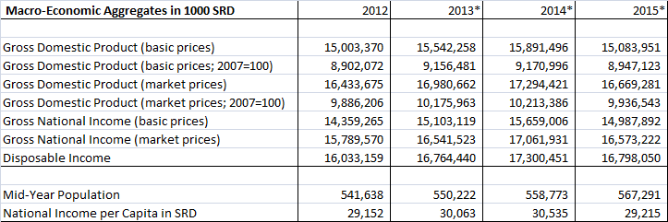
Table: Macro Economic Aggregates

Slide 16
Thank you for your attention!!

